Slide 1

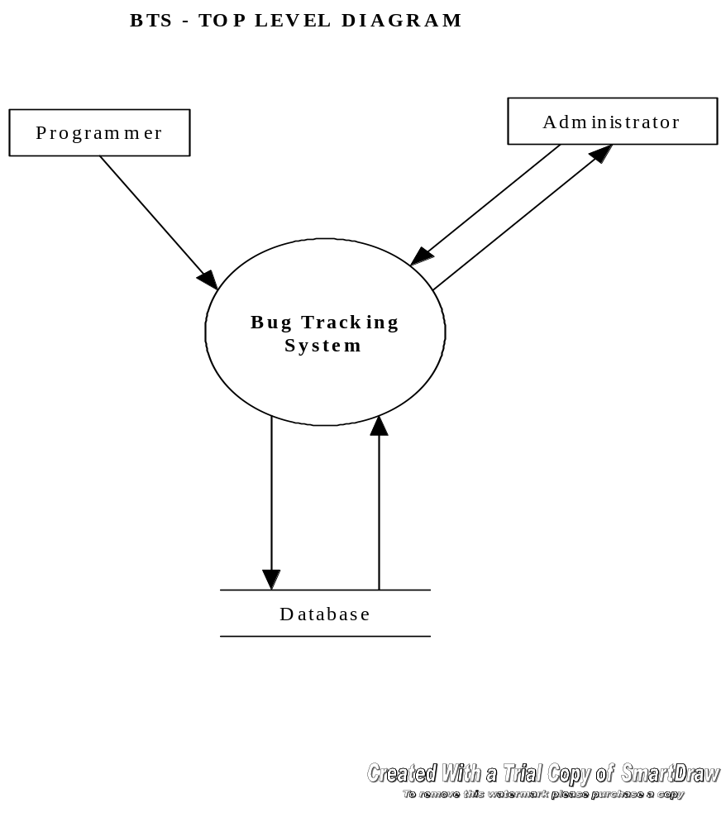
OBJECT DESIGN (DFD-1)

Slide 2
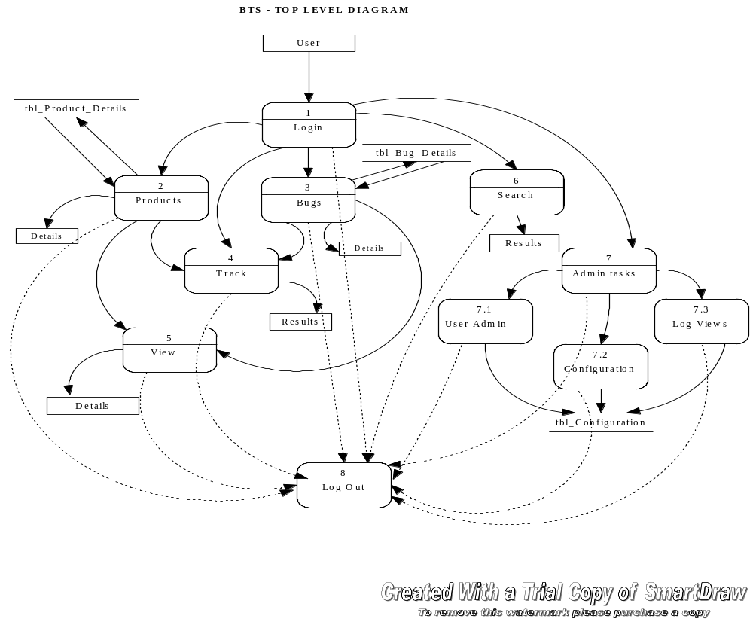
OBJECT DESIGN (DFD-2)

Slide 3
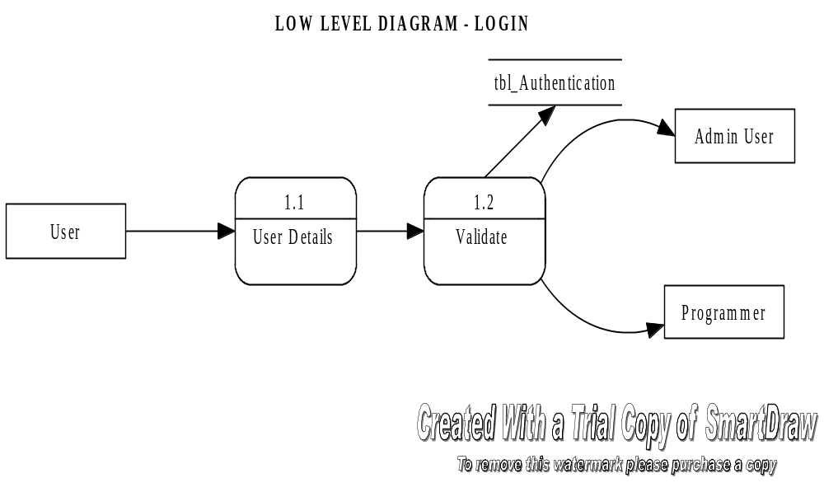
OBJECT DESIGN (DFD-3)

Slide 4
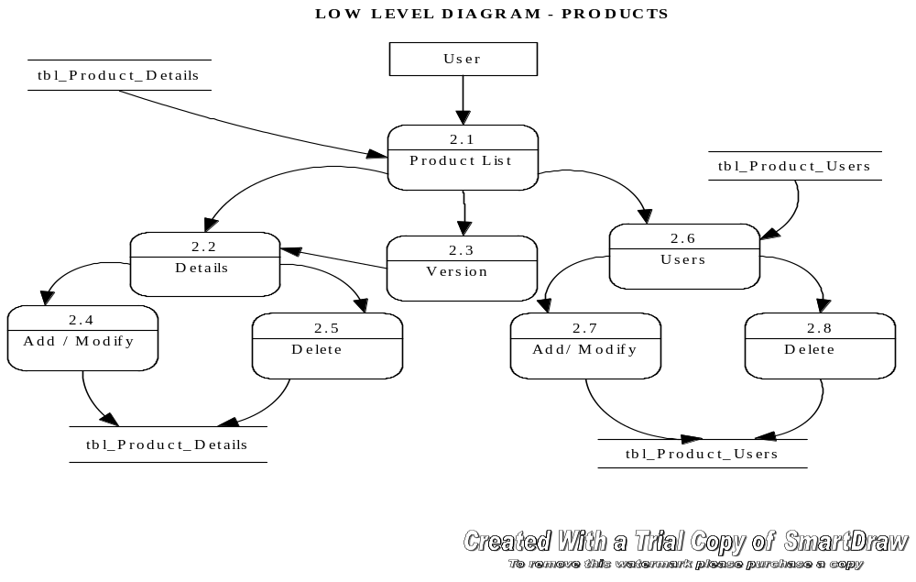
OBJECT DESIGN (DFD-4)

Slide 5
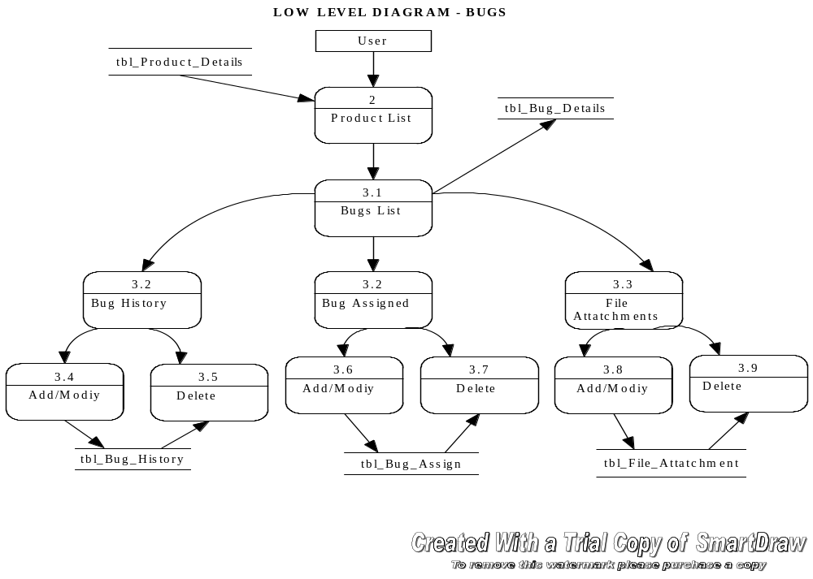
OBJECT DESIGN (DFD-5)

Slide 6
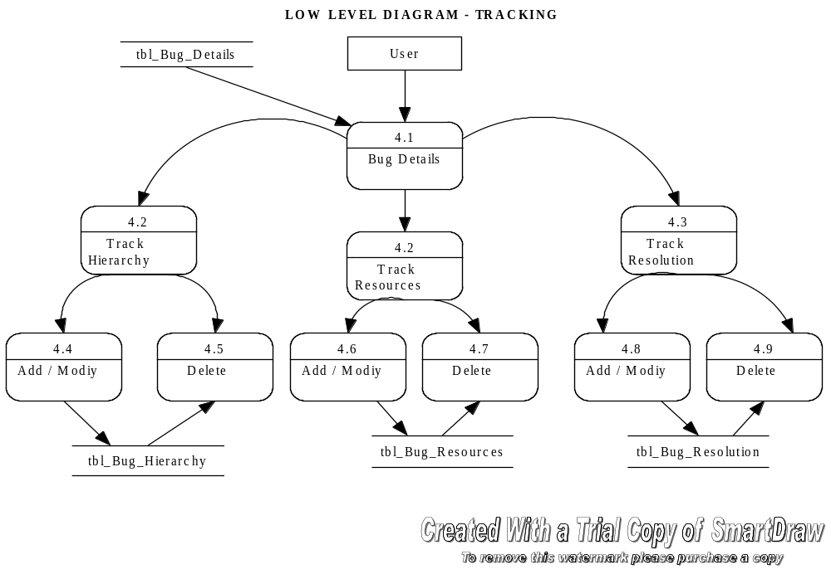
OBJECT DESIGN (DFD-6)

Slide 7
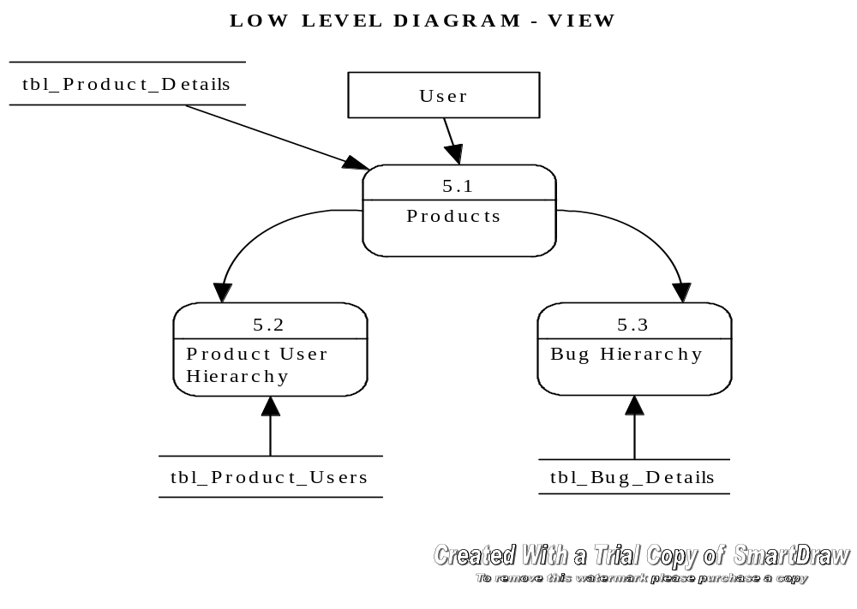
OBJECT DESIGN (DFD-7)

Slide 8
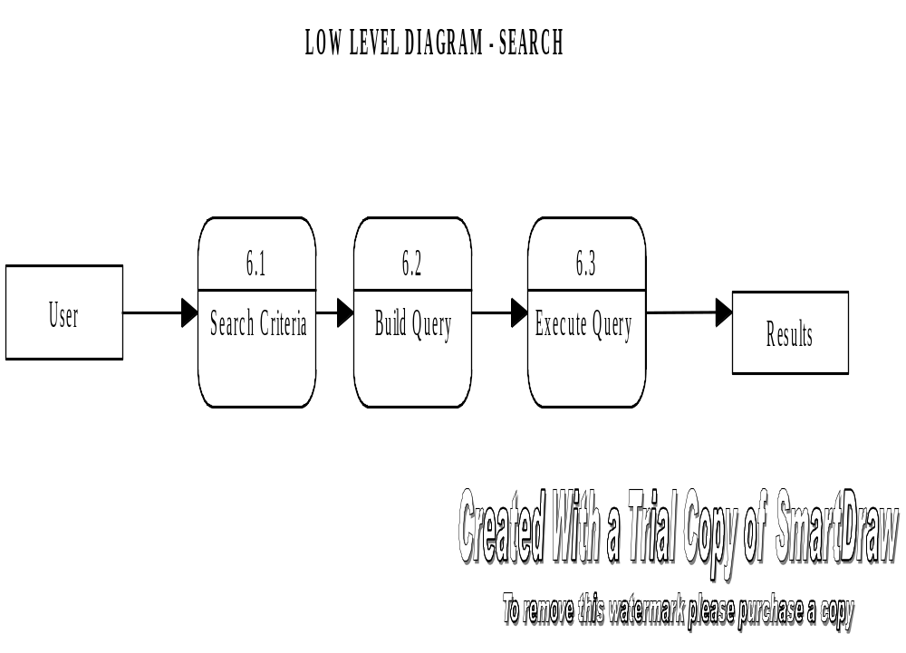
OBJECT DESIGN (DFD-8)

Slide 9
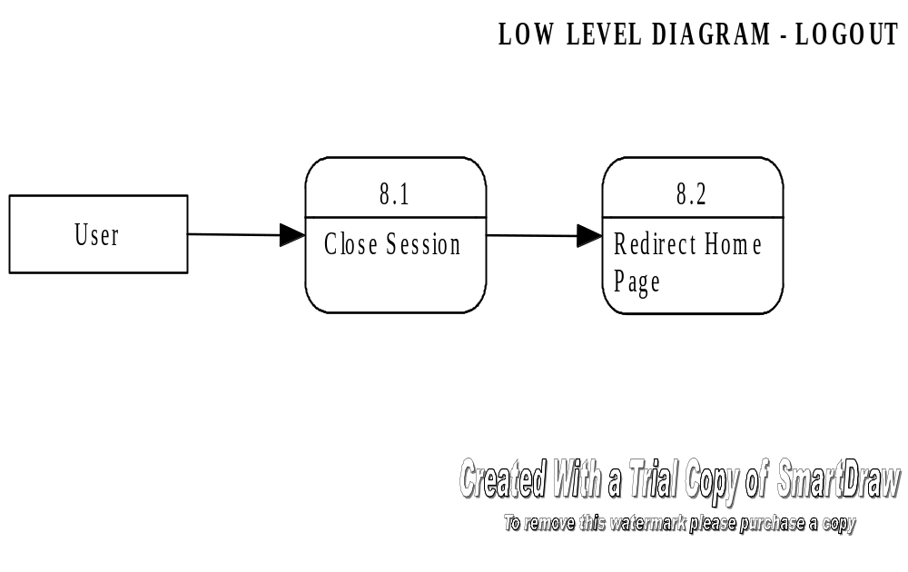
OBJECT DESIGN (DFD-9)

